Slide 1
OBJECT DETECTION

Slide 2
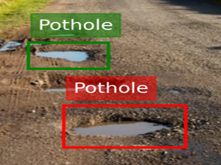
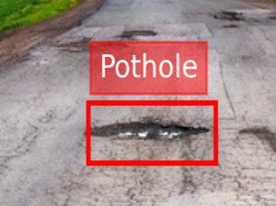
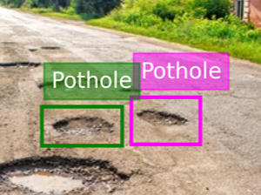
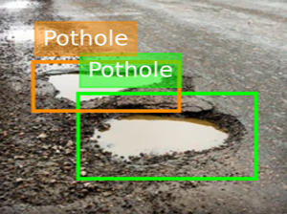
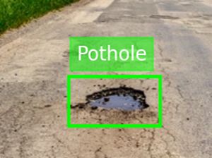
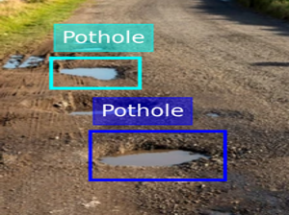
OBJECT DETECTION
Object detection is to find and recognize objects in an image or video. It not only identifies what objects are present but also shows their exact locations using boxes.
Object Classification – Identifying what the object is (e.g., car, person, dog).
Object Localization – Determining where the object is in the image using bounding boxes.
Multiple Object Detection – Detecting and identifying multiple objects in the same image or video.

Slide 3
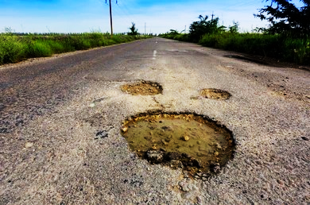

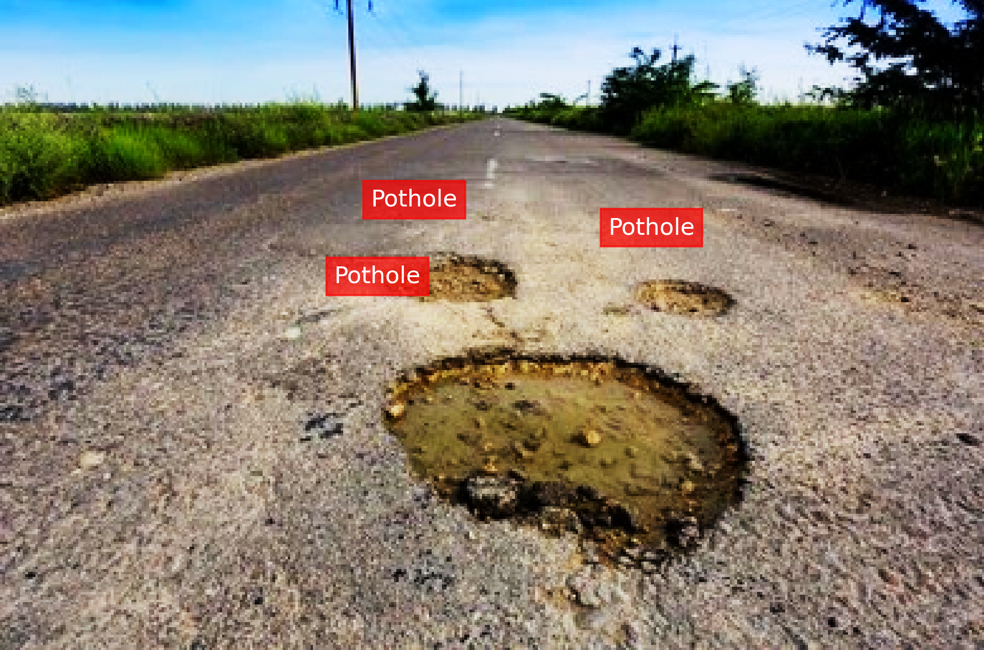
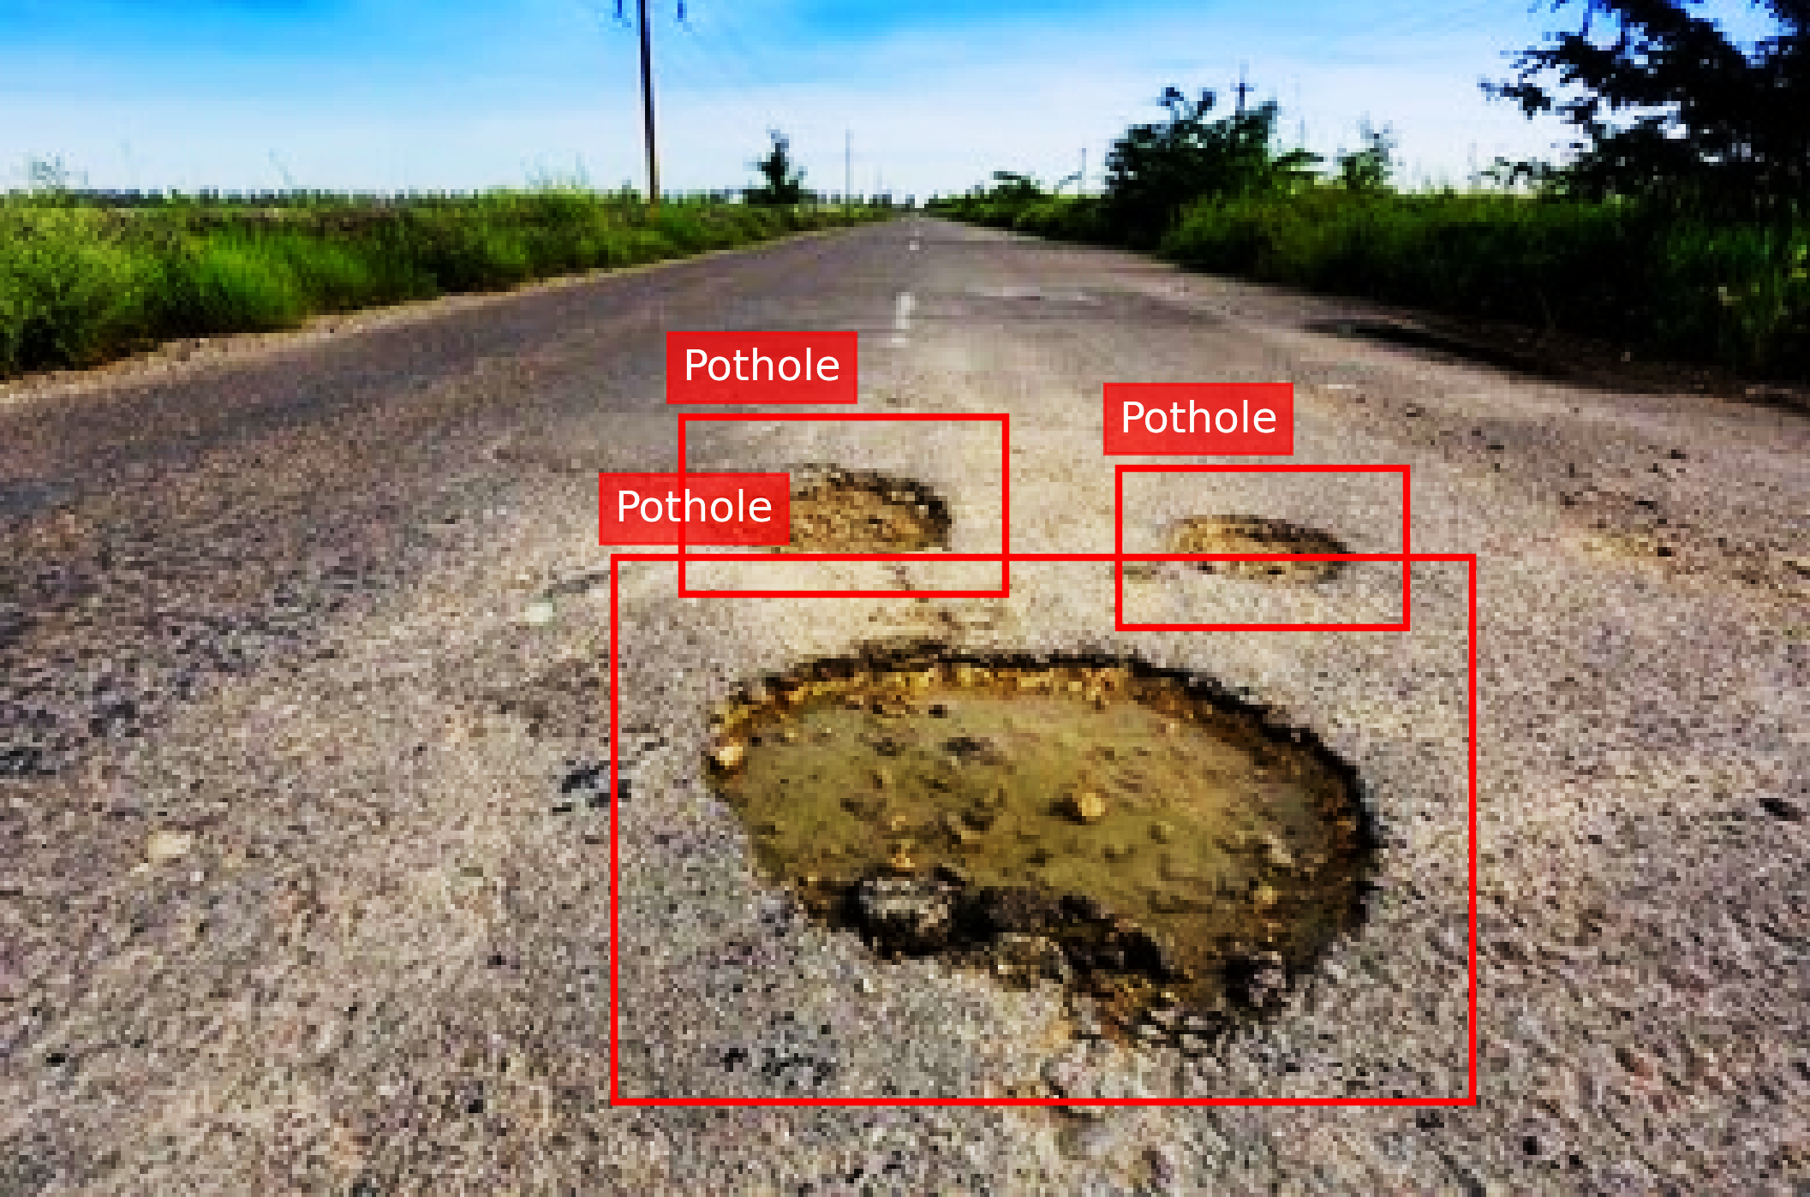
IMAGE
WORKING
LOCALIZATION
CLASSIFICATION
OBJECT DETECTION

Slide 4
OBJECT DETECTION MODELS
01
02
03
FASTER
RCNN
SSD
YOLO

